Slide 1

Project Presentation
ROBUST SECURE COLOR IMAGEWATERMARKING USING 4D HYPERCHAOTIC SYSTEM, DWT, HbD and SVD BASED ON IMPROVED FOA ALGORITHM
Group No. 36
Project Supervisor –
Prof. Sangeeta Mangesh
Group Members
Shivani Chaudhary (1809131144)
Trisha Singh (1809131161)
Vineet Kumar Singh (1809131176)
DEPARTMENT OF ELECTRONICS AND COMMUNICATION ENGINEERING

Slide 2
INDEX
Problem Statement
Literature Survey
Objective
Block Diagram
Flow Chart
Work To be done till next presentation
References

Slide 3
PROBLEM STATEMENT
The key problem in designing a tamper detection, localization and recovery scheme is how to increase the ability of the scheme to detect and localize tampering areas with high accuracy and ensuring the imperceptibility of the recovered image.
The existing methods did not provide expected accuracy of detection and recovery opportunities for relatively high tampering.

Slide 4
LITERATURE SURVEY
Publication/Year | Title | Overview | Positive Aspects | Limitations
Hindawi/2021 | Robust Secure Color ImageWatermarking Using 4D Hyper chaotic System, DWT, HbD, and SVD Based on Improved FOA Algorithm | The motive of the author was to eradicate watermarking issues | DWT,SVD and HbD techniques are used | The implemenattion of techniques must be done properly
Science Direct/2020 | Optimised robust watermarking technique using CKGSA in DCT-SVD domain | embeds a watermark to minimise the problem of illegal copying and disseminating multimedia contents | Using DCT and SVD techniques | The trade-off between invisibility and robustness has always been a challenging issue in watermarking methods and it needs optimization
IEEE/2019 | Digital Watermarking Techniques and its Application towards Digital Halal Certificate: A Survey | The ease of alterations, distributions and duplications of a digital data makes the multimedia security to be crucial | Machine Learning algorithms are used | The analyzation of watermarking techniques is a task

Slide 5
OBJECTIVE
To implement an optimized and robust watermarking algorithm coupled with a 4D hyperchaotic system, and its performance is analyzed by extending and differentiating the existing work.
To identify ownership of the copyright of the signals.
To overcome the problems like copyright infringement, watermarking attacks, and security issues.
To reduce the size of the encrypted data and improve the space efficiency.
To improve robustness by coefficient modification through HbD.

Slide 6
BLOCK DIAGRAM
Watermarked
Image with
Noise
Watermarked
Image
Watermark Embedding Algorithm
Attacks and Noise
Watermark Detection Algorithm
Original
Image
Watermark
Recovered Watermark

Slide 7
FLOWCHART
Host Image
Implement embedding procedure
Watermarked Image
Attack 1
Attack 2
Attack 3
Implement extraction and decryption procedure
NO
If Watermark Extraction
YES
Extracted Watermarked
Compute PSNR, SSIM, NC

Slide 8
EXPECTED WORK TO BE COMPLETED TILL NEXT PRESENTATION
To find other attacks causing infringement.
analyze noise and filtering.
To obtain original image from noising.

Slide 9
REFERENCES
Robust Secure Color ImageWatermarking Using 4D Hyperchaotic System, DWT, HbD, and SVD Based on Improved FOA Algorithm https://www.hindawi.com/journals/scn/2021/6617944/
DWT-SVD BASED SECURED IMAGE WATERMARKING FOR COPYRIGHT PROTECTION USING VISUAL CRYPTOGRAPHY https://www.researchgate.net/publication/266504033_DWT-SVD_BASED_SECURED_IMAGE_WATERMARKING_FOR_COPYRIGHT_PROTECTION_USING_VISUAL_CRYPTOGRAPHY
Optimised robust watermarking technique using CKGSA in DCT-SVD domain https://www.sciencedirect.com/science/article/pii/S2214212620308693

Slide 10
INDEX
Objective
Work updates
Work done from previous presentation
Expected work to be completed by next presentation

Slide 11
OBJECTIVE OF THE PROJECT
To implement an optimized and robust watermarking algorithm coupled with a 4D hyperchaotic system, and its performance is analyzed by extending and differentiating the existing work.
To identify ownership of the copyright of the signals.
To overcome the problems like copyright infringement, watermarking attacks, and security issues.
To reduce the size of the encrypted data and improve the space efficiency.
To improve robustness by coefficient modification through HbD.

Slide 12
WORK UPDATES
We tried to compute remaining attacks found in an image like rotation, jpg compression, brightness etc.
We had analyzed image using filtering and different types of noise.
We tried to retain an original image from noising.

Slide 13
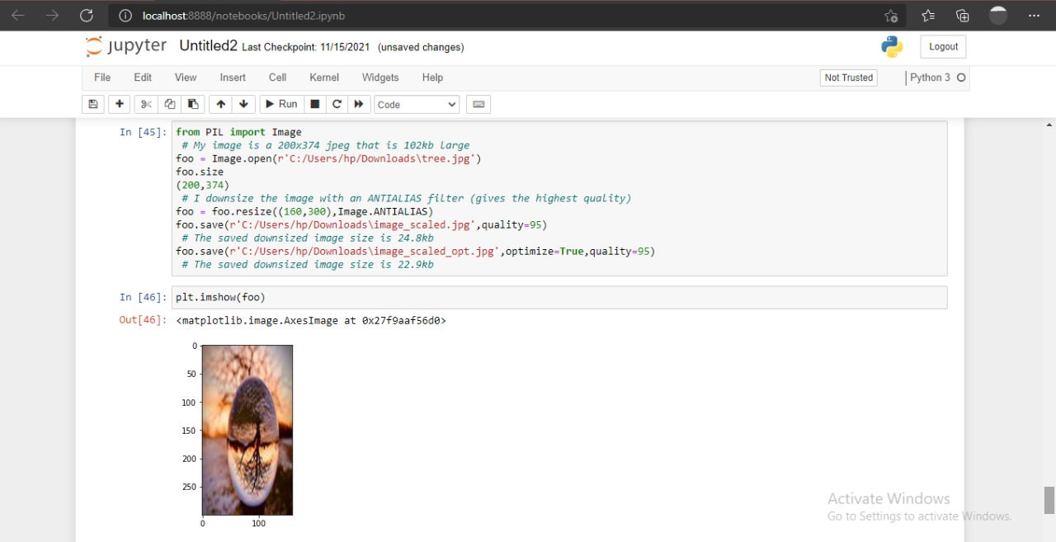
WORK DONE FROM PREVIOUS PRESENTATION
Attack: Compression

Slide 14
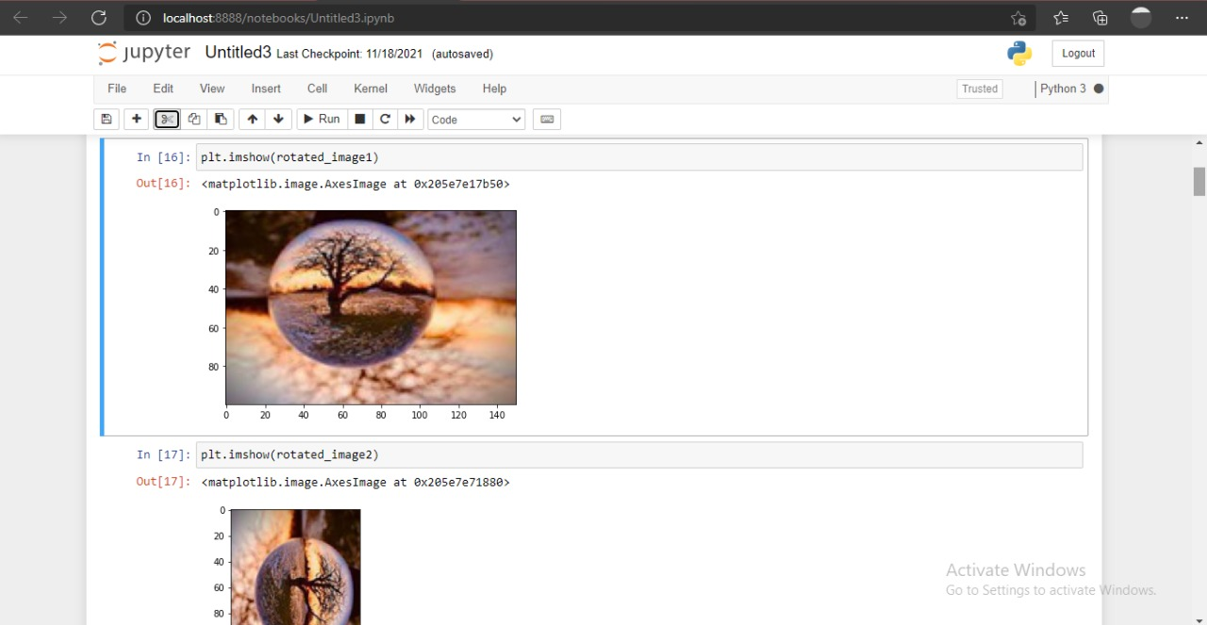
WORK DONE FROM PREVIOUS PRESENTATION Attack: Rotation

Slide 15
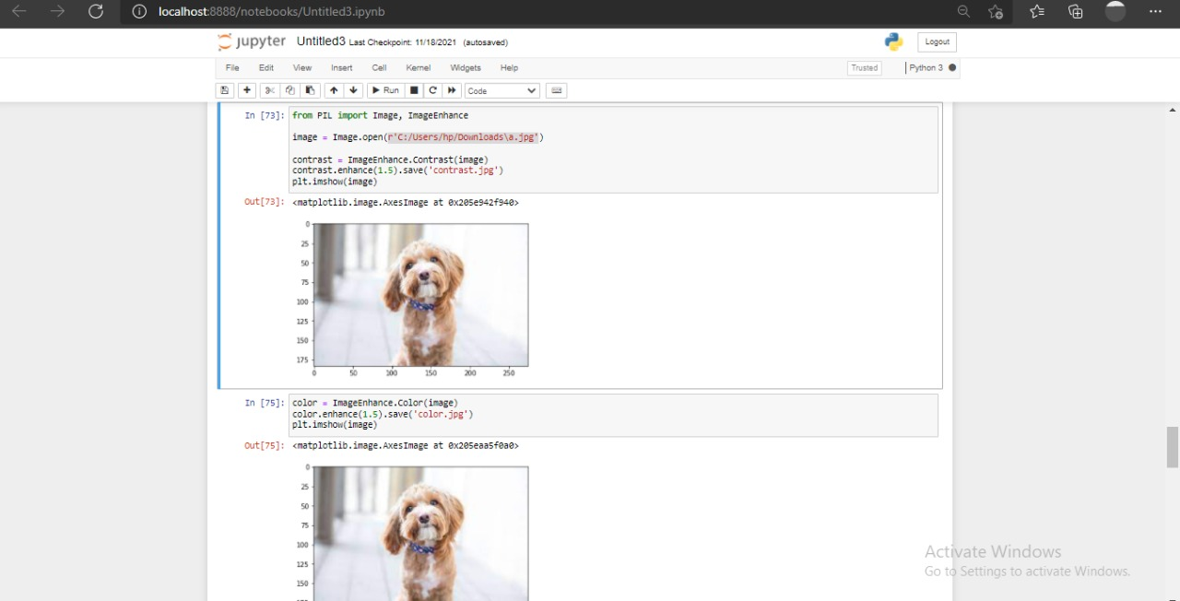
WORK DONE FROM PREVIOUS PRESENTATION Image enhancement: Contrast

Slide 16
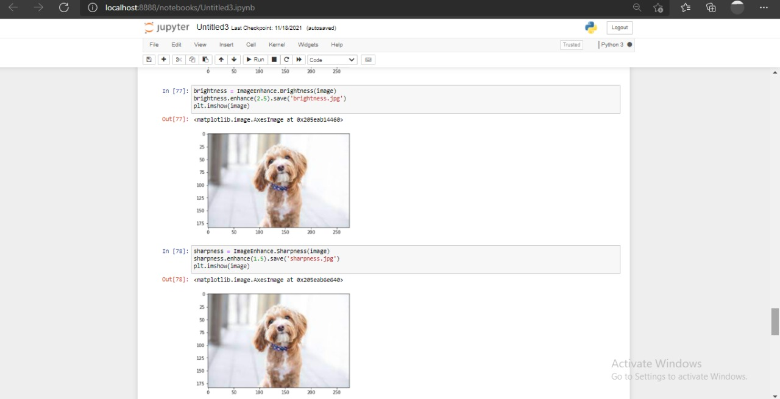
WORK DONE FROM PREVIOUS PRESENTATION Image enhancement: Brightness and Sharpness

Slide 17
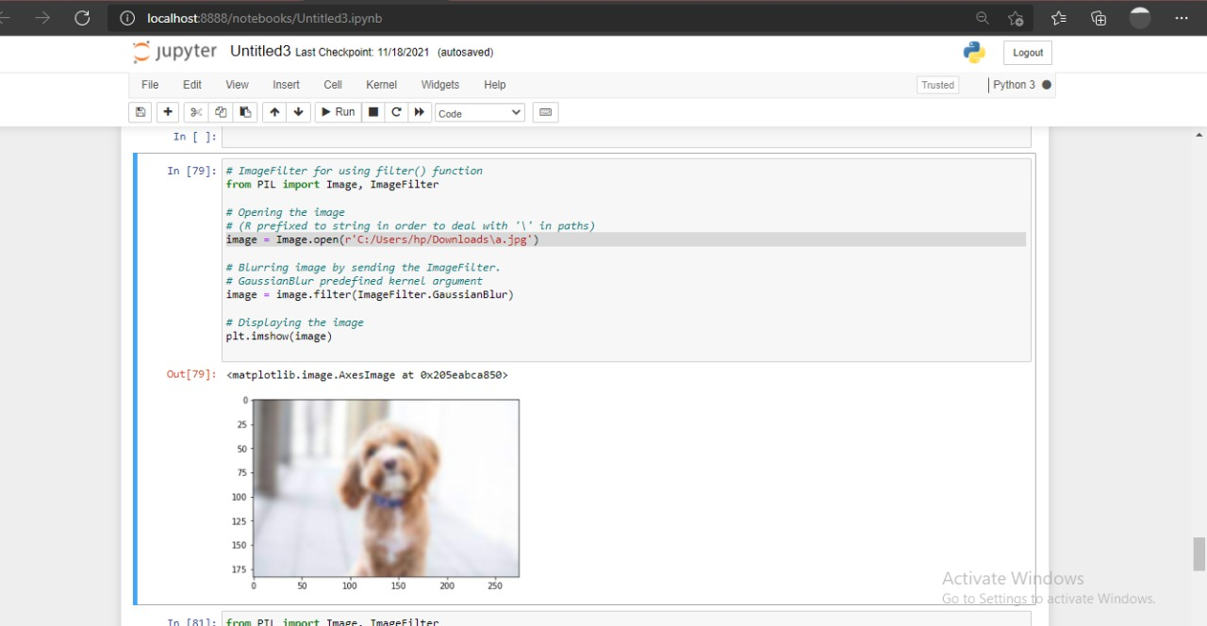
WORK DONE FROM PREVIOUS PRESENTATION Image Filtering: Gaussian Blur

Slide 18
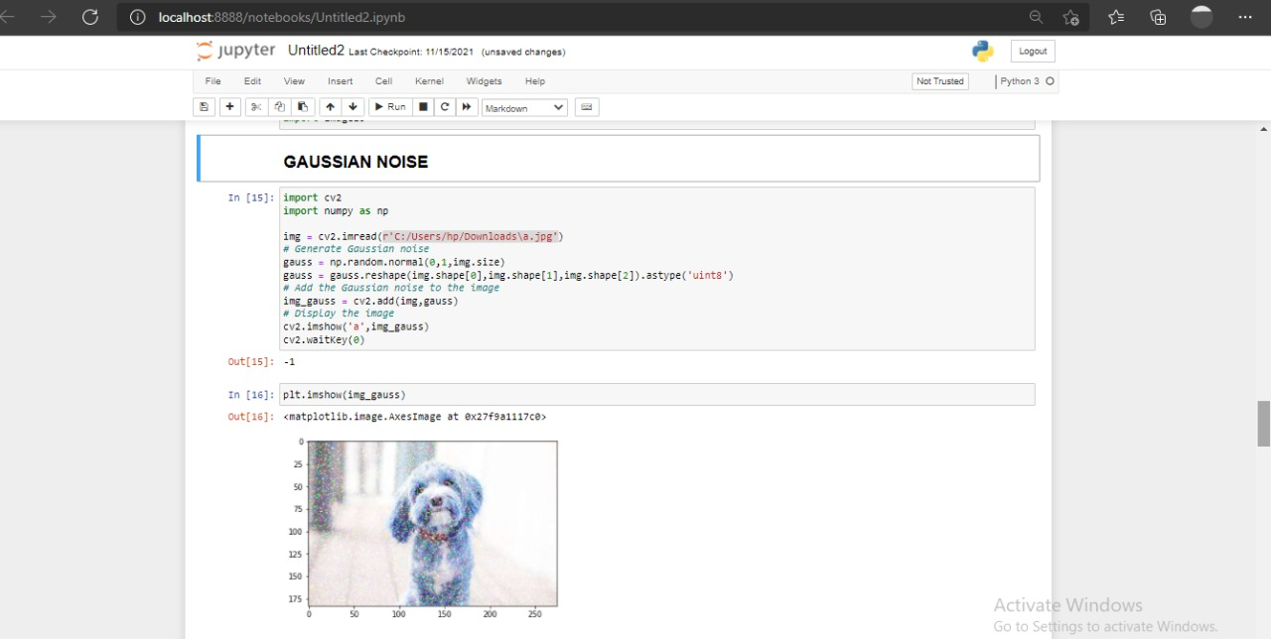
WORK DONE FROM PREVIOUS PRESENTATION Noise attack: Gaussian Noise

Slide 19
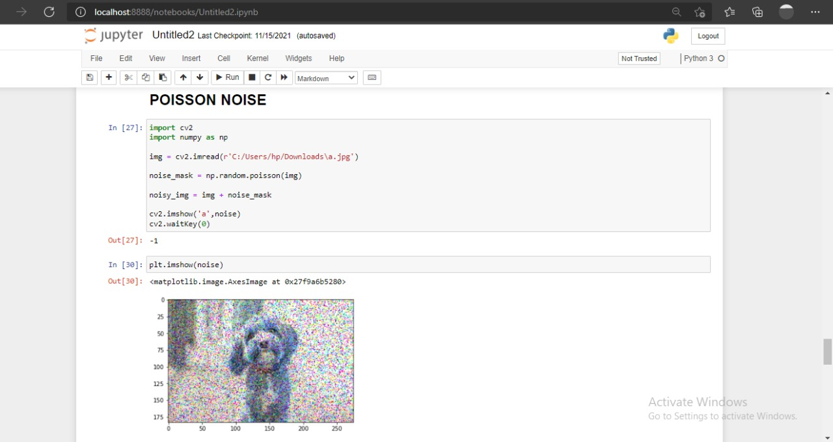
WORK DONE FROM PREVIOUS PRESENTATION Noise attack: Poisson Noise

Slide 20
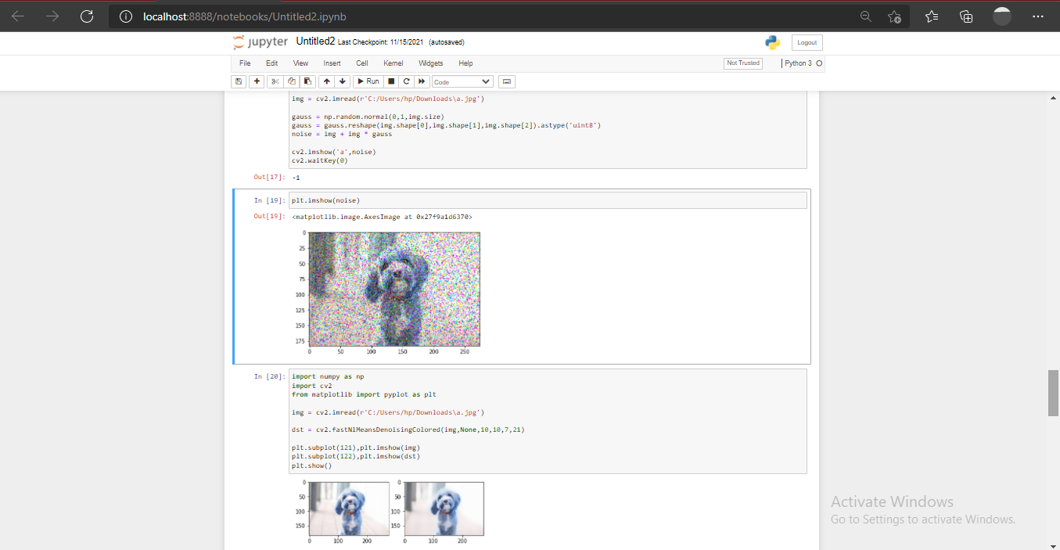
WORK DONE FROM PREVIOUS PRESENTATION
Retaining an original image from noising

Slide 21
EXPECTED WORK TO BE COMPLETED TILL NEXT PRESENTATION
To perform transformation technique i.e. Discrete Wavelet Transform.
To compute Peak signal to noise ratio (PSNR) and SSIM using
software as well as manually.
To perform decomposition technique i.e. Singular Value
Decomposition.

